Slide 1

Group Project: ANT Truck Data Analysis
MIS 6346, Summer 2022
Group 8:
Sanika Jadhav
Amish Vyas
Nikita Prakash Deshmukh
Tamothara Raja Venkatreddy Nata
Hazim Qudah
Dharmateja Chelamalasetty

Slide 2
Business Objectives
One of the leading causes of injuries and deaths in the United States are the accidents caused by large trucks.
The objectives of our project are:
To identify the dangerous commercial truck drivers by analyzing the dataset based on various factors such as geographic location, vehicle type, average mileage, events, and Risk Factors.
To identify top 10 risky drivers based on their events reported and provide training to reduce the risk
To identify top 10 risky routes where events reported are high and therefore sending skilled drivers in that route
To identify event & event rates, mileage per model, therefore identifying models with less safety features, less efficient, such as blind spot, lane departure warning etc., and not to buy those model vehicles for business
Workload Management Dashboard in order to balance workload between drivers and models

Slide 3

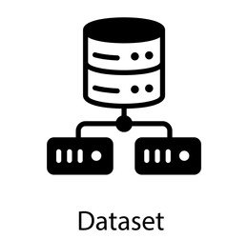



Process Flow
Move Files from local Directory to HDFS
Download the Dataset
Load Data into Cloudera VM
Visualize the data
Import Data in the Impala

Slide 4
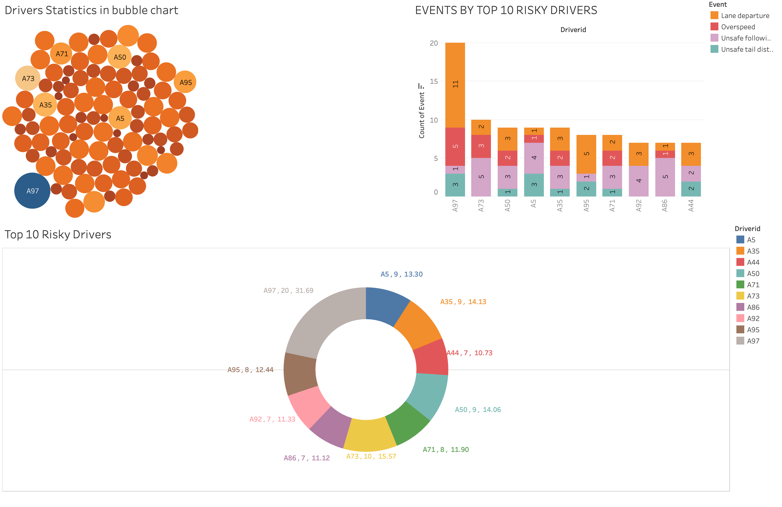
Dashboard: Risky Drivers & Their Events
In this dashboard we showcase three different visualizations depicting driver statistics by risk factors and # of events occurred while driving.
For the bubble chart, each bubble represents 1 of 100 drivers, and color intensity depicts average risk factor. Driver A97 is the riskiest driver.
For the stacked bar chart, we explore the top 10 risky drivers and the count and type of events occurred.
For the donut chart, we combine insights from above two charts to represent riskiest drivers, number of events, and average risk factor.
Footer information
Notes:
Takeaway from this slide: we note A97 to be the riskiest driver having been part of 20 events [11 lane departures, 5 overspeeding, 1 unsafe following, 1 unsafe tail]. Seems like lots of drivers have issues with lane departure, we should focus on training this up.
Top riskiest drivers: A97, A43, and A50

Slide 5
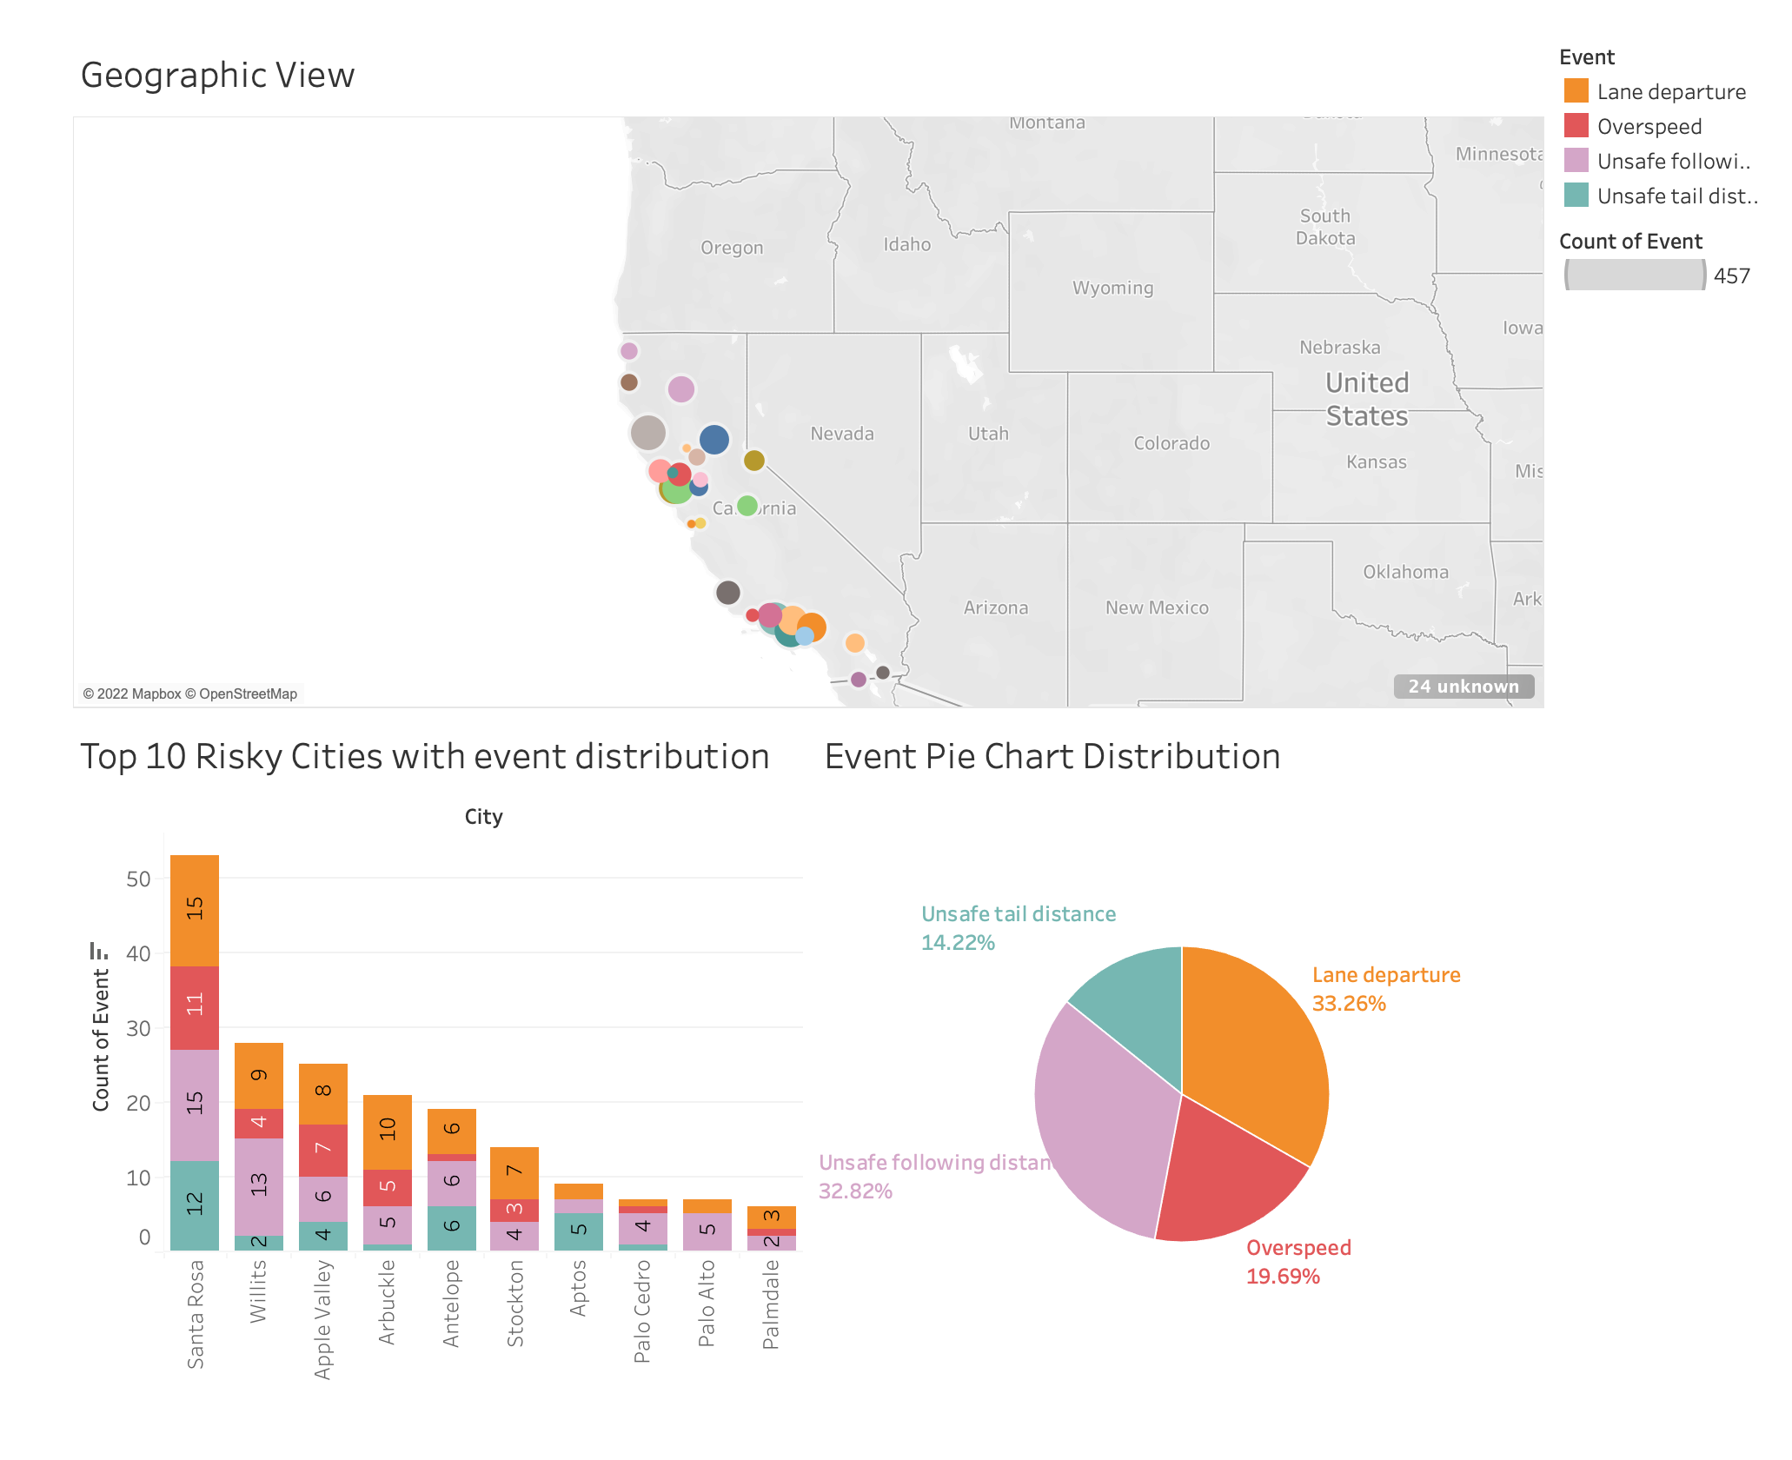
Dashboard: Riskiest 10 Cities
In this dashboard we analyze the top 10 riskiest cities
The map view shows the high clustering of unsafe events in North and South California
The stacked bar graph reflects Santa Rosa as the riskiest city with a total of 53 unsafe events
We can also observe that lane departure and unsafe following distance are the most occurring event with the trucks and addressing them can drastically decrease the risk factor.
Footer information
Notes:
Takeaways: from this slide we note that lane departure + unsafe following distance are equally as problematic from a geographic perspective.

Slide 6
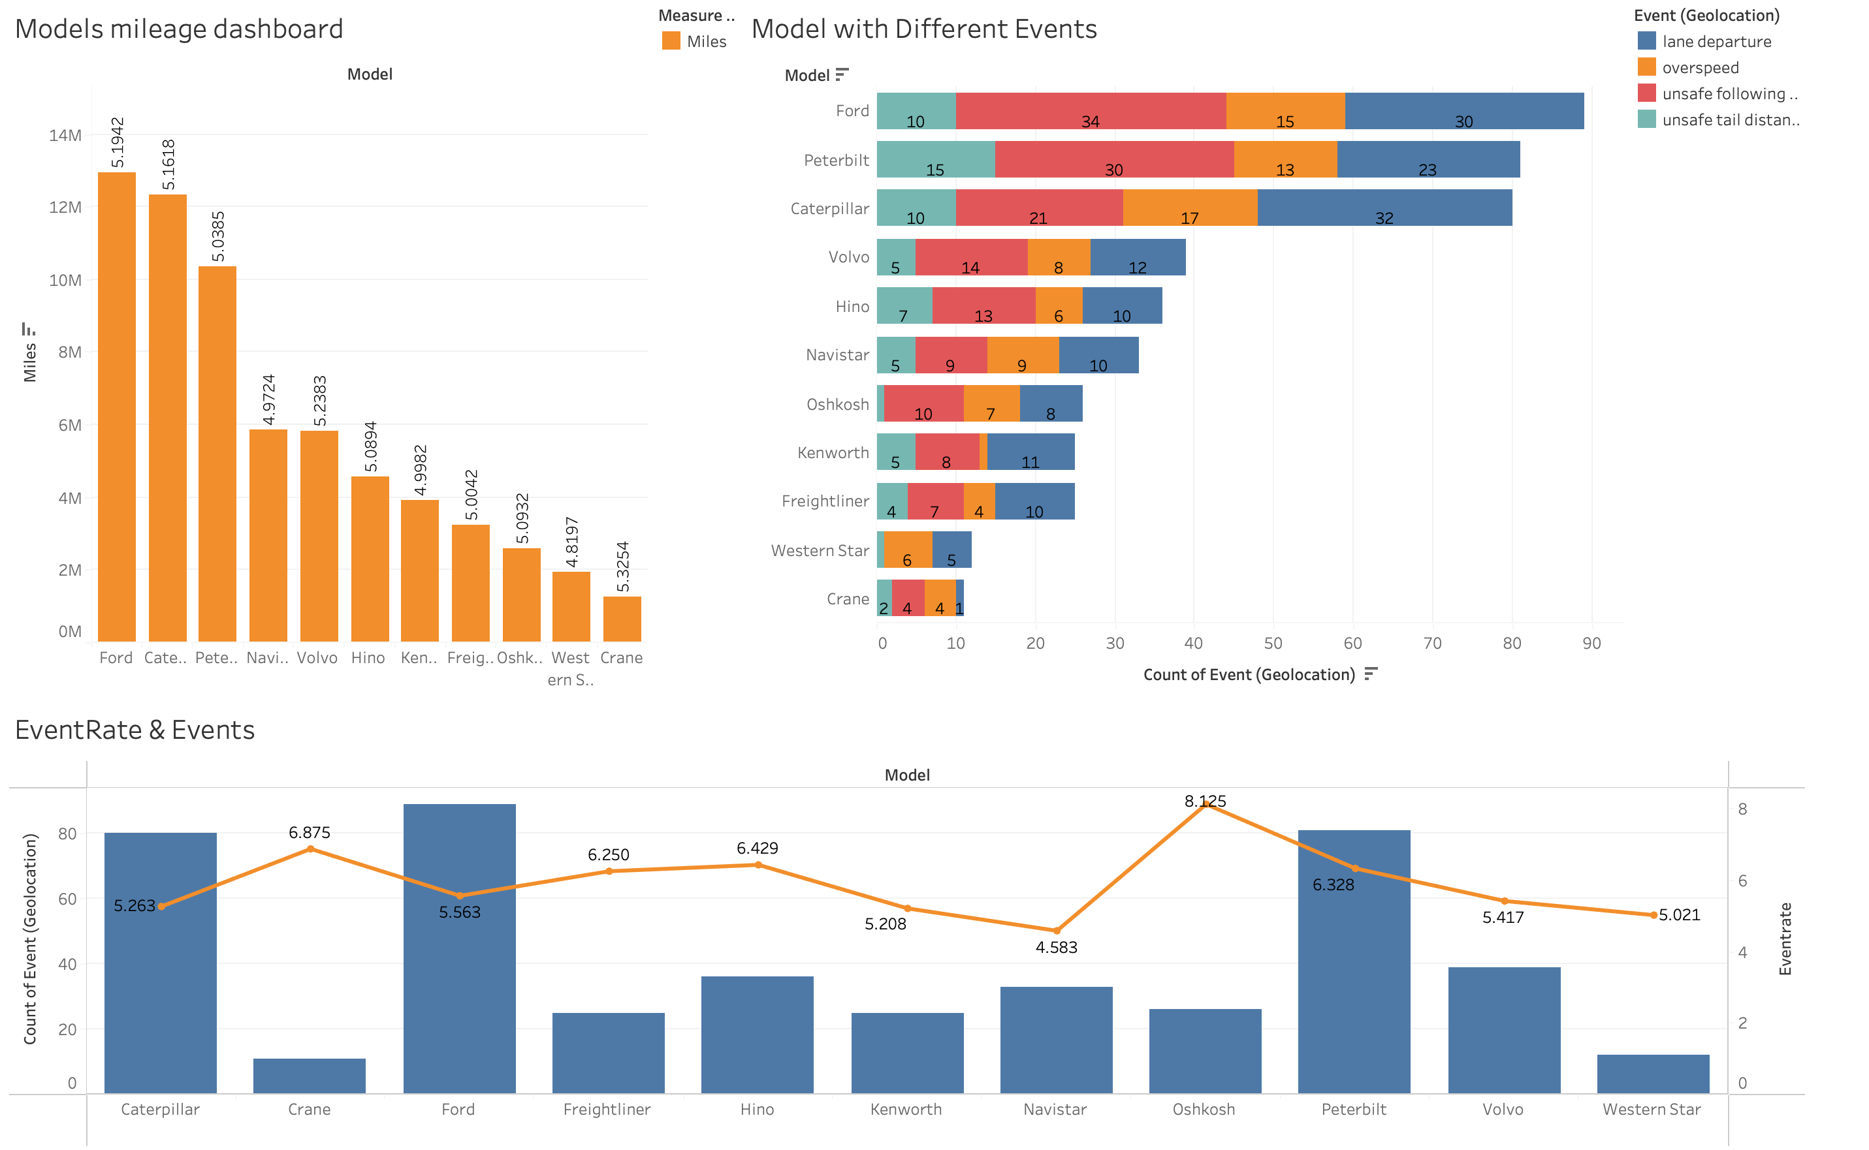
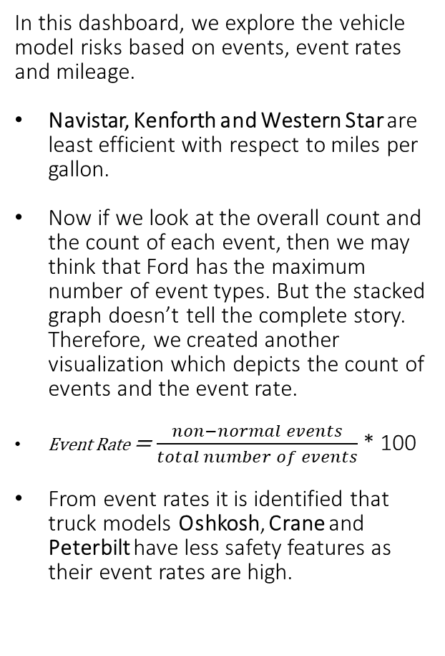
Dashboard: Truck Model type and Risk Statistics
In this dashboard, we explore the vehicle model risks based on events, event rates and mileage.
Navistar, Kenforth and Western Star are least efficient with respect to miles per gallon.
Now if we look at the overall count and the count of each event, then we may think that Ford has the maximum number of event types. But the stacked graph doesn’t tell the complete story. Therefore, we created another visualization which depicts the count of events and the event rate.
Event Rate = $\frac{non−normal events}{total number of events}$ * 100
From event rates it is identified that truck models Oshkosh, Crane and Peterbilt have less safety features as their event rates are high.
Footer information

Slide 7
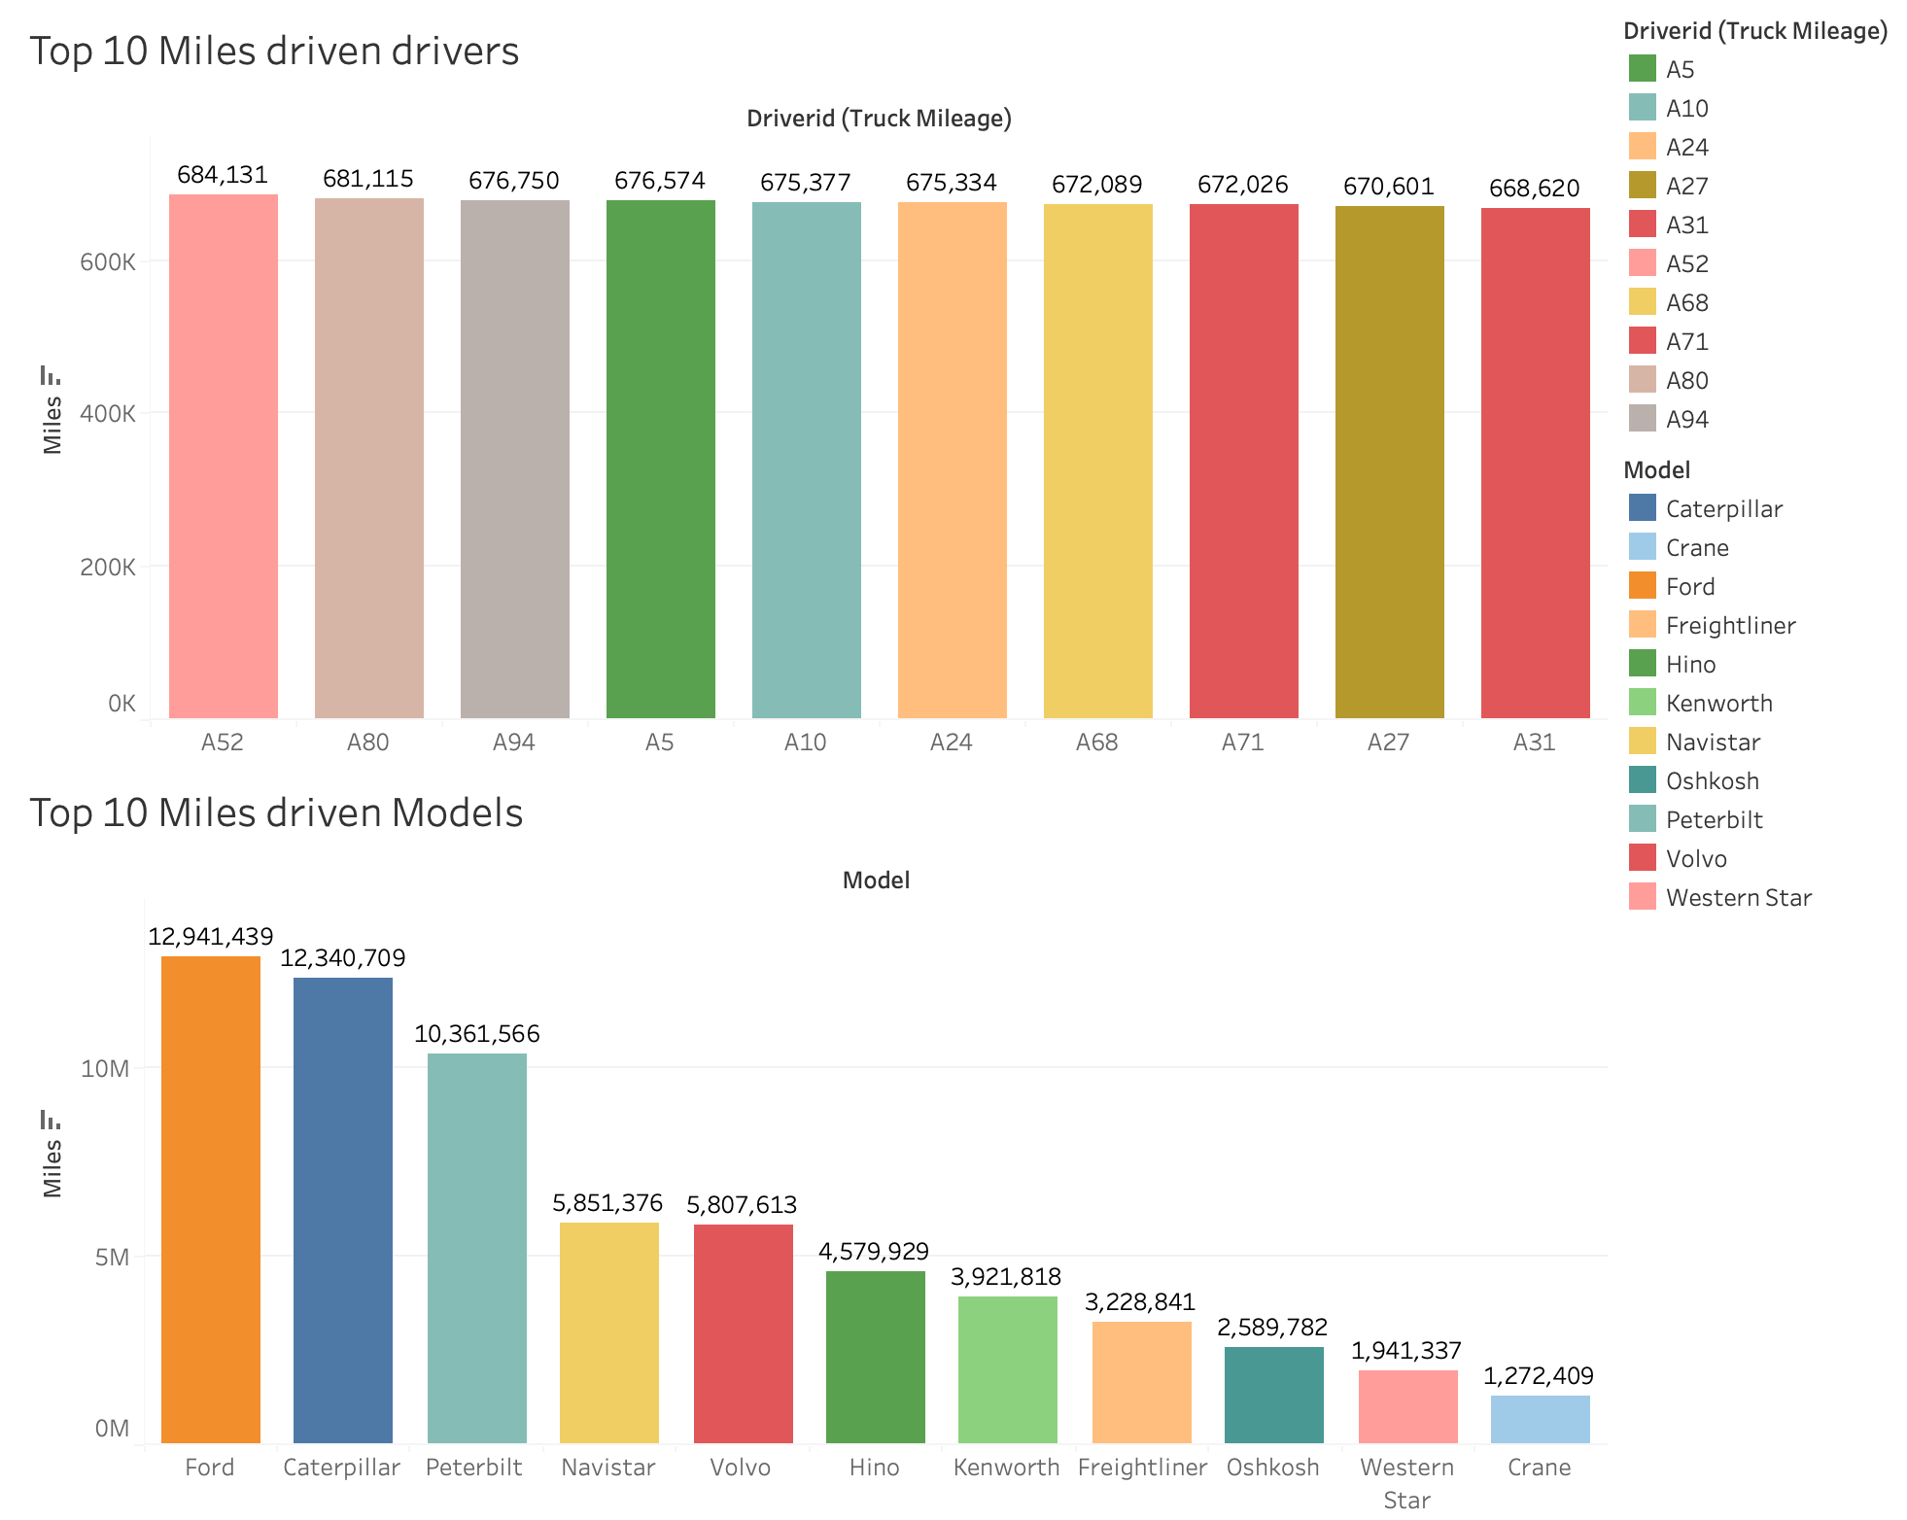
Dashboard: Workload Management
In the workload mgmt. dashboard, we explore the top 10 drivers & Models by the number of miles driven
In order to check least performing drivers, we map the top 10 drivers. We can define an expected threshold @ the organizational level to ensure all drivers are performing efficiently.
In the bottom report we note vehicles with the highest mileages driven, organization should pay extra attention to the highest driven models for two reasons:
a) Ensure most run vehicles are routinely serviced to avoid incidents.
b) Strategically invest in more number trucks of the most fuel-efficient type
Footer information
Notes:
Top riskiest drivers: A97, A43, and A50
A52:
A80:
A94:

Slide 8
Challenges
Creation of small aggregation tables in order to display events + event rates. Creation of new table by joining data from EventRiskFactor and Geolocation to display top 10 risky drivers + the events reported by those top 10 risky drivers.
Above can be achieved by creating calculation fields but in order to not to overload dashboard, we created tables as these are one-time tasks.
Optionally we could run these calculations as batch processes overnight or use a streaming approach w/ IoT for real-time insights.
In any scenario we are still using the computational power of Hadoop rather than local PC/server with Tableau as a visualization layer.
Footer information

Slide 9
Conclusion
ANT should create detailed trainings for drivers based upon specific events rather than generalizing training for all drivers. For example, Driver A97 should be specifically trained to minimize lane departure events.
ANT leadership can decide alternative routes for the geographies with higher events or they can assign most skilled drivers for the risky routes. On the flip side, ANT should incentivize drivers with safer track records.
From model risk statistics, ANT can invest and buy more of those models which has lowest event rates than other models.
ANT can create automated alert system to identify models which have reached threshold for high # of miles driven → in this scenario we should distribute our work amongst different models.
Overall analysis could be improved by enriching geographical data with other factors such as weather, road, and environmental conditions to produce predictive analytics on expansion plans.

Slide 10

Thank you

